Slide 1
Development of Artificial Robotic Arm based on Tactile Sensor
Internship at Biorobotics Institute, Pisa, Italy

Slide 2
Team
Mentor:
Prof. Calogero Oddo
Vinit Sarode
Sapan Agrawal
Notes:
The Biorobotics Institute: http://www.santannapisa.it/en/institute/biorobotics/biorobotics-institute
VNIT Nagpur: http://www.vnit.ac.in/
Prof. Calogero Oddo: http://sssa.bioroboticsinstitute.it/user/102

Slide 3
Cyberphysical Architecture
Environment
ARM Cortex A-9 Processor
Air Cylinder
Festo Pneumatic Muscles
Air
Pressure Controller
Air
Tactile Sensor
Power System

Slide 4
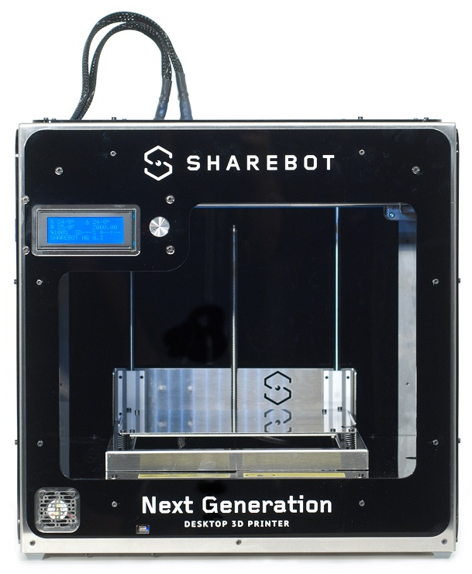
3D Printing Technology
To produce stronger and lighter parts quickly.
To reduce the part manufacturing cost.
To produce multiple part prototypes easily and independently.
Available Printer Technologies:
FDM (Fused Deposition Modelling)
SLS ( Selective Laser sintering)
DLP (Digital Light Processing)

Slide 5
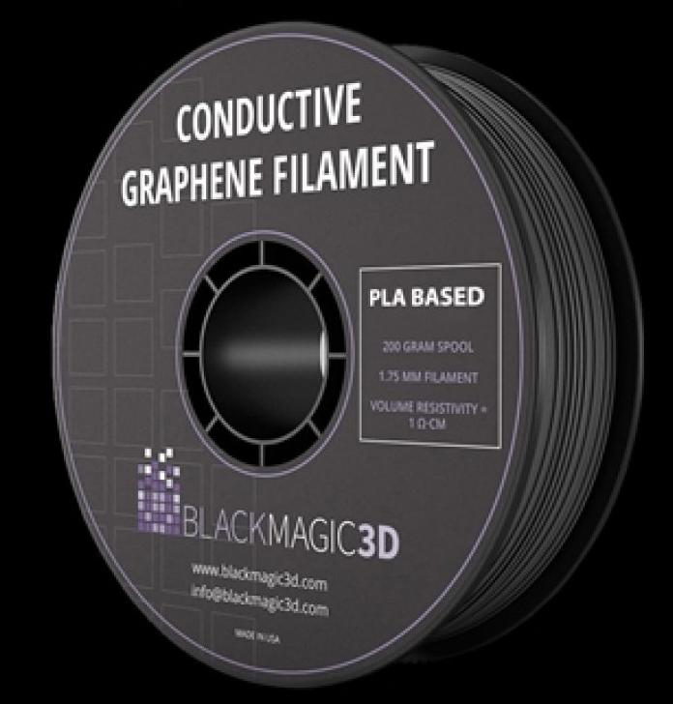
Use of Graphene in 3D Printing
Enhances the mechanical strength , thermal and electrical conductivity.
Used in developing batteries, Sensors, EMI and radiofrequency Sheets.
Used for conductive paths which could be directly printed in the parts.
Notes:
https://3dprintingindustry.com/news/what-can-we-3d-print-with-graphene-filament-56303/

Slide 6
Graphene Filament Manufacturers
Afinia Graphene Enhanced PLA ( 50$/400gm)
BlackMagic3D HIPS Carbon Fiber Graphene (40$/350gm)
Conductive Graphene PLA Filament (55$/100gm)
Grafylon PLA+Graphene (19.32$/350gm)
GraphenePLA (23$/500gm)

Slide 7
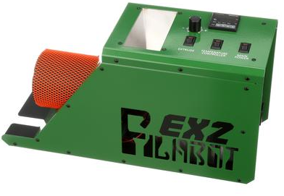
Filament Production
Can produce both 1.75mm and 2.85 mm filament.
Can be used to recycle the waste printed materials.
Heating the mixture of Graphene and Pellets will form the composite which can be then shredded and fed to the Filabot.
Filabot Filament Extruder

Slide 8
Strength & Ductility Enhancement
Benefits of cementitious composites: enhancement in strength, ductility, fracture energy by incorporating micro-sized inert carbonized particles in cementitious composites.
0.08 wt.% addition of micro sized inert carbonized bamboo particles enhances the flexural strength and toughness up to 66% & 103% resp. of cement composites.
Cement composites are the heterogeneous materials composed of complex micro, mezzo and macro structure.
Increased w/c (water-cement) ratio reduces the mechanical strength of C-S-H (Calcium silicate hydrate) at nano scale and consequently results in lower strengths of cement composites.
Literature shows that the use of fly ash, silica fume, ground granulated blast furnace slag, lime stone powder, bentonite, metakaolin, glass powder, rice husk, coconut shell and wheat straw ashes in the cementitious composites as a partial replacement of cement have several positive effects on their performance, such as improved workability, consistency, thixotropy, compressive strength and durability.

Slide 9
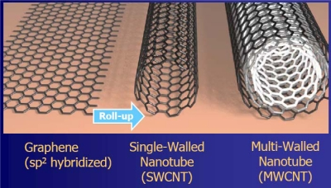
Need of CNT and Graphene Nanocomposites
Degradation of High temperature mechanical properties.
Low fracture toughness.
Poor creep
Deprived thermal shock resistance.
Notes:
CES :https://www.youtube.com/watch?v=nbuu7UD2GVk
Reference: Recent Advances on Carbon Nanotubes and Graphene Reinforced Ceramics Nanocomposites.

Slide 10
Graphene Reinforced Ceramic Nanocomposites
For bulk engineering, few layered graphene platelets including reduced graphene oxide (GO) are more economical and viable.
Mechanical Clevage Method and Hummers method are used to obtain graphene ceramics mixture.
GNP’s (Graphene Nano Platelets) have better dispersion due to less van der Waal's forces, high specific area and 2D geometry.
Colloid Processing using anionic and cationic surfactants (to alter charge on GNPs and opposite material) is preferably used dispersion technique.
The graphene securely anchors around the base material, thus requires high pulling out energy than CNTs.

Slide 11
Benefits of GNP
Enhances mechanical performance (235% facture toughness in Al2O3).
Improves wear resistance.
Stabilizes base material thermally and chemically.
Increases the thermal conductivity.
Converts base material into a functional material like sensors, electric shielding, electrodes, conducting paths, etc.

Slide 12
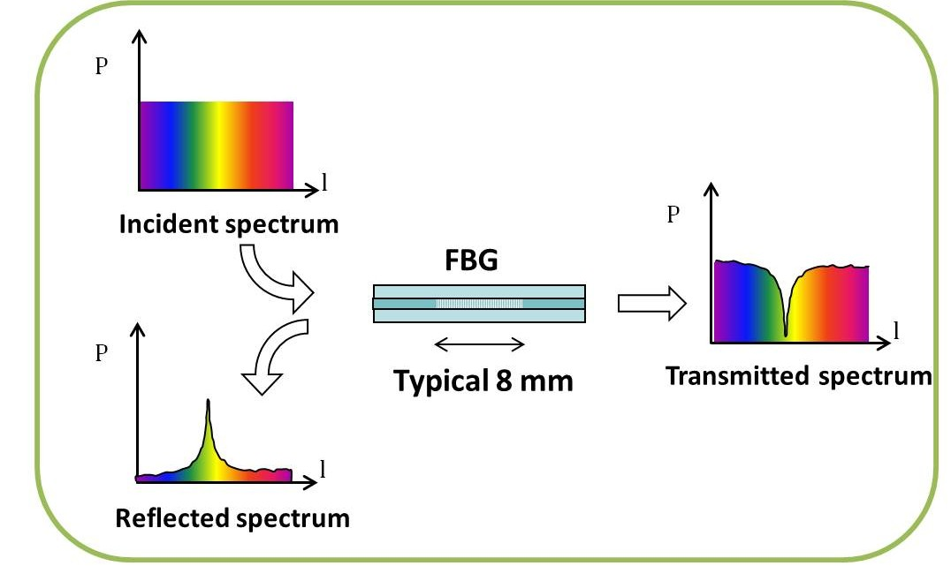
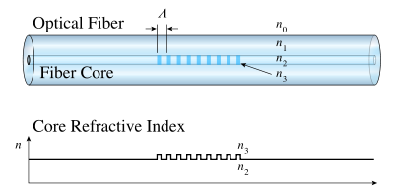
Fiber Bragg Grating (FBG) Principle
FBG is a short segment of optical fiber that reflects a particular wavelength of light and transmits the rest.
The periodic refractive index (RI) of Germanium doped silica fiber is obtained by exposing UV light ( function of intensity and duration).
The FBG works on the principle of Fresnel Reflection where the light travelling between media of different RI may both reflect and refract.
The central wavelength of the reflected one is the Bragg’s wavelength which depends on the spatial grating period.
The grating Length changes w.r.t strain induced in the FBG and the change in temperature.

Slide 13
Benefits of FBG:
1. It avoid issues related to light intensity
2. Fast response
3. Negligible hysteresis
4. Possibility to discriminate uniform & non-uniform load adapting FBGs with special design.

Slide 14
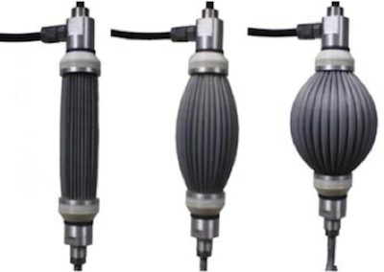
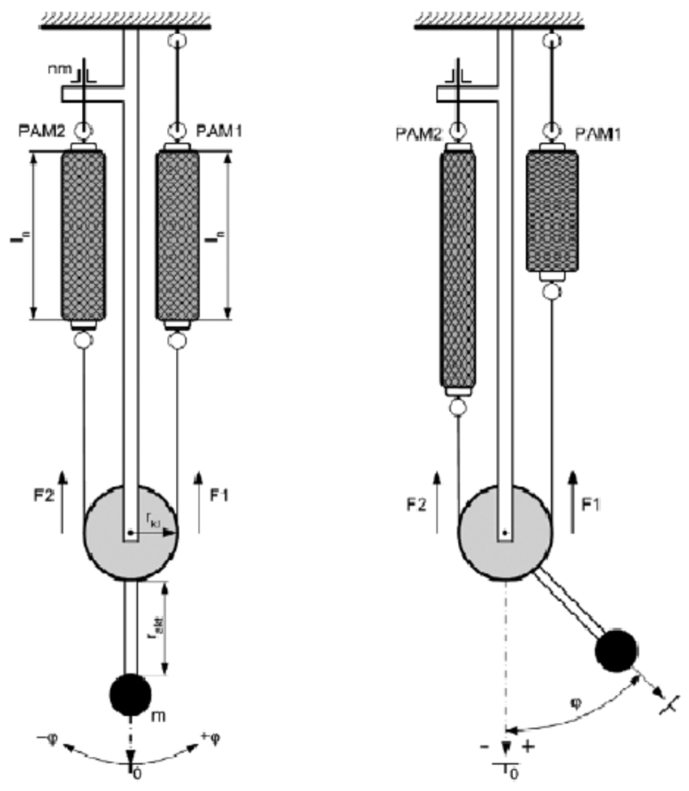
Actuators
Pneumatic Artificial Muscles (PAM) are contractile or extensional devices operated by pressurized air filling a pneumatic bladder. (Also known as McKibben Artificial Muscles)
They are usually grouped in pairs of agonists and antagonists.
The muscles consist of an inflatable inner tube/bladder inside a braided mesh, clamped at the ends. When the inner bladder is pressurized and expands, the geometry of the mesh acts like a scissor linkage and translates this radial expansion into linear contraction
Notes:
https://www.festo.com/cat/en_us/products_010606

Slide 15
Benefits of PAM
Lightweight (due to use of thin membrane)
Compliant behaviour (When a force is exerted on PAM, it “gives in” , without increasing the force in actuation.)
Relationship between force & extension in PAMs and length-tension relationship in biological muscle systems are very similar.
Force in them is not only dependent on pressure but also on their state of inflammation.

Slide 16
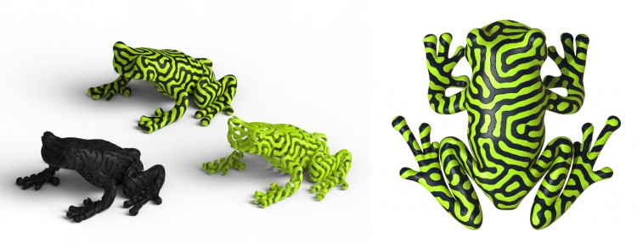
Reaction- Diffusion by Nervous System

Slide 17
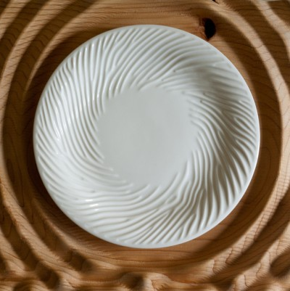
Reaction- Diffusion by Nervous System [Link]
The strip pattern was generated using simulation of reaction – diffusion, a mathematical model that can be used to simulate the skin patterns of various animals.
The firm now uses the technique commercially to make anticraft and jewelry.
[Video Link 1]
[Video Link 2]

Slide 18
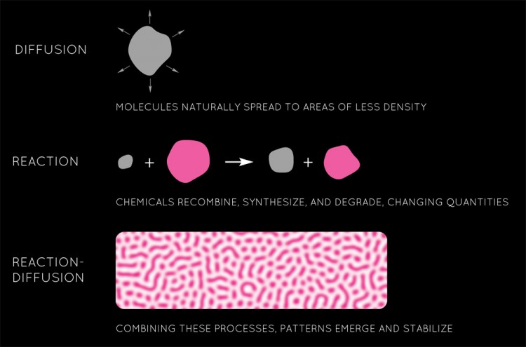
Reaction- Diffusion by Nervous System

Slide 19
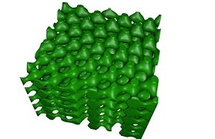
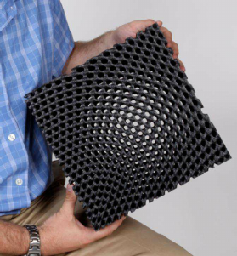
3d Spatially Variant lattices
Algorithm to spatially vary and functionally grade all of the attributes of a periodic structure independently and simultaneously while still rendering the overall lattice smooth and continuous.
Attributes include unit cell orientation, lattice spacing, fill fraction, geometry, material composition, and more.
It is still in research phase at University of Texas at El Paso by EMLab. They are using MATLAB to develop lattices and Blender software to give them the desired shapes.
http://emlab.utep.edu/research.htm
[Video Link 1]
[Video Link 2]

Slide 20
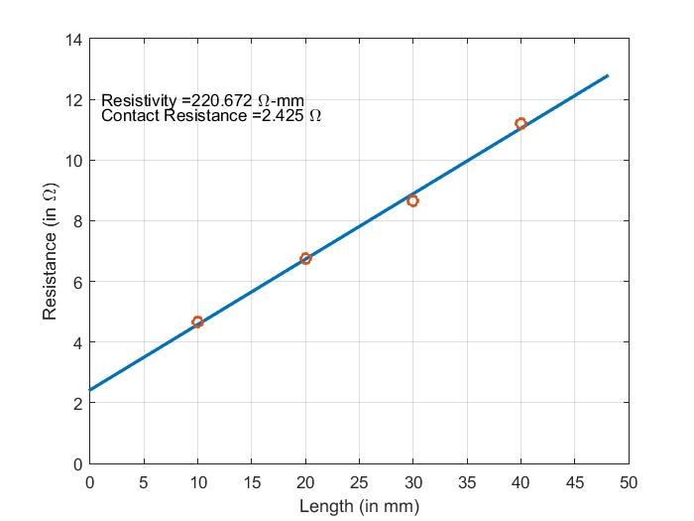
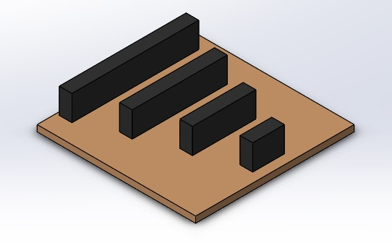
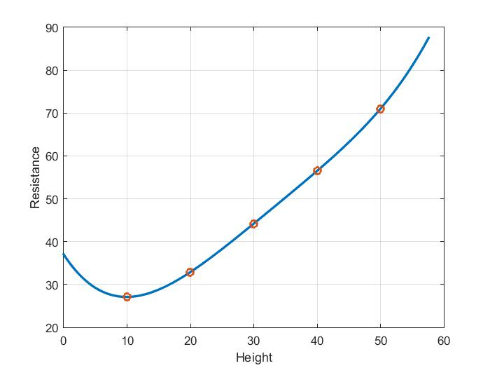
Resistivity Measurement
Length | 4mmX8mm (in Ω)
10mm | 4.65
20mm | 6.75
30mm | 8.65
40mm | 11.2
Height | 4mmX8mm (in Ω)
10mm | 27.1
20mm | 32.9
30mm | 44.2
40mm | 35.2 & 56.5
50mm | 71

Slide 21
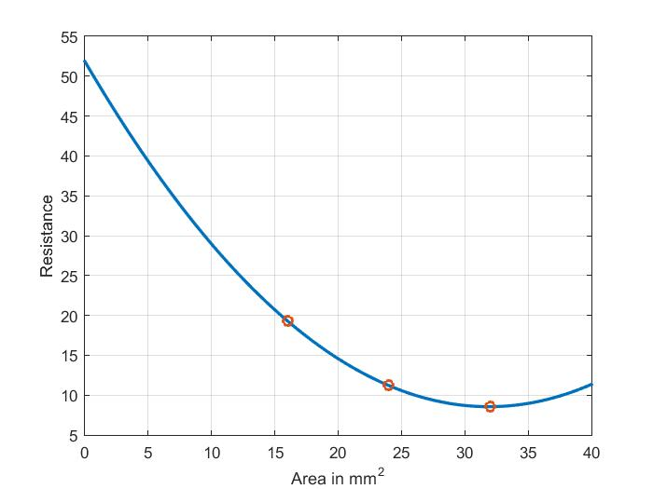
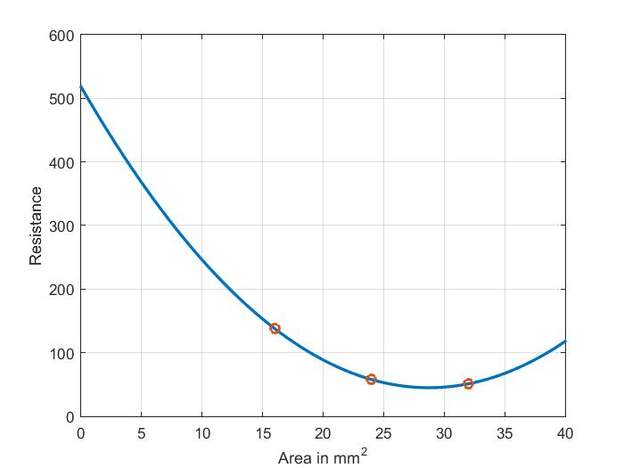
Variation in Area of Cross Section
Area | 30mm (Length) (in Ω)
4mmX4mm | 19.3
4mmX6mm | 11.2
4mmX8mm | 8.55
Area | 30mm (Height) (in Ω)
4mmX4mm | 137.85
4mmX6mm | 57.8
4mmX8mm | 51.1

Slide 22
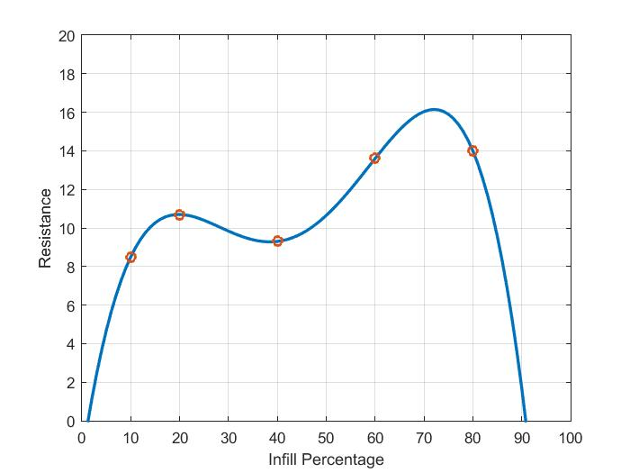
Variation in Infill Percentage
Infills | 4mmX8mm (in Ω)
10% | 8.5
20% | 10.7
40% | 9.3 & 7.5
60% | 13.6
80% | 14

Slide 23
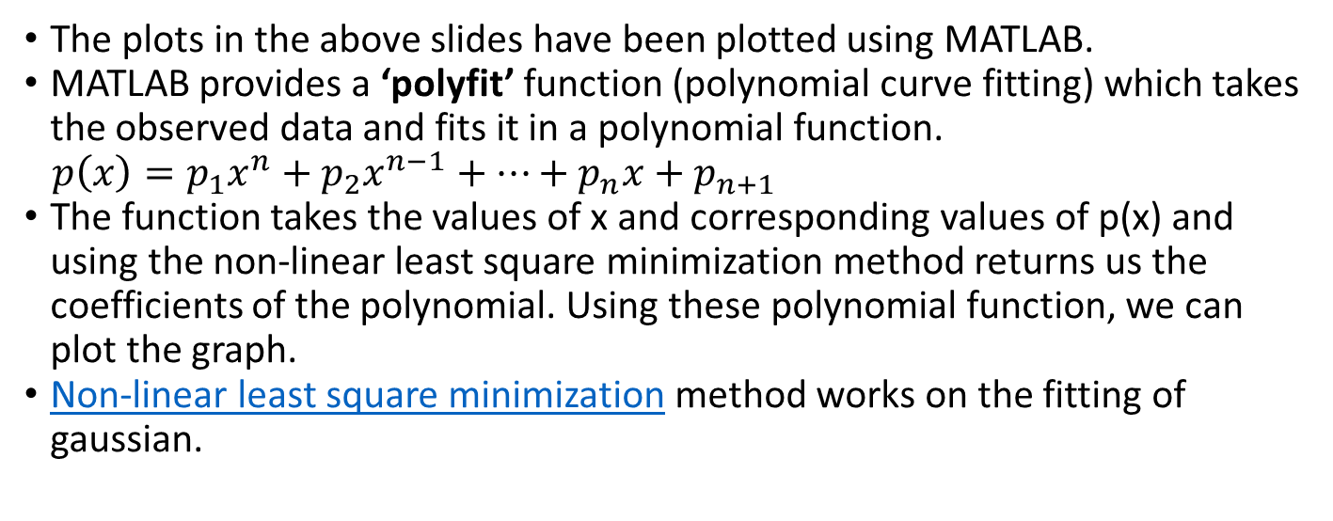
Graphene Characterization
The plots in the above slides have been plotted using MATLAB.
MATLAB provides a ‘polyfit’ function (polynomial curve fitting) which takes the observed data and fits it in a polynomial function.
$p\left(x\right)=p_{1}x^{n}+p_{2}x^{n−1}+…+p_{n}x+p_{n+1}$
The function takes the values of x and corresponding values of p(x) and using the non-linear least square minimization method returns us the coefficients of the polynomial. Using these polynomial function, we can plot the graph.
Non-linear least square minimization method works on the fitting of gaussian.

Slide 24
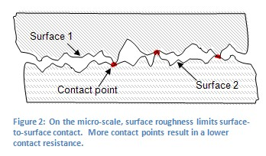
Contact Resistance
The effect of contact resistance was immediately seen when the resistance of graphene composed PLA was measured using multimeter.
The contact resistance comes into play due to smaller area of intimate contact between the two surfaces.
The fluctuation was observed due to the contact resistance being comparable to the resistance being measured.
The contact resistance can be reduced using the Silver Conductive Paint.

Slide 25
Joint Limits
Sr. No. | Action | Muscles |  | Min Length (Contraction) | Upper Limit | Lower Limit
 |  | Agonist | Antagonist
1. | Shoulder Abduction/Adduction | Deltoid |  | 200mm (50mm)
2. | Shoulder Flexion/Extension
3. | Medial/Lateral Rotation
4. | Elbow Flexion/Extension
5 | Pronation/ Suppination

Slide 26
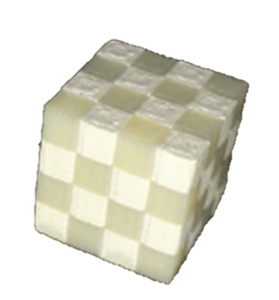
3D printing of polymer matrix composites
The structural strength and functionality of 3D Printed parts can be improved by use of matrix and reinforced composites.
Research has been made in making simple geometry matrix composites.
However, controlled proportion mixing of different materials have not been achieved yet.

Slide 27
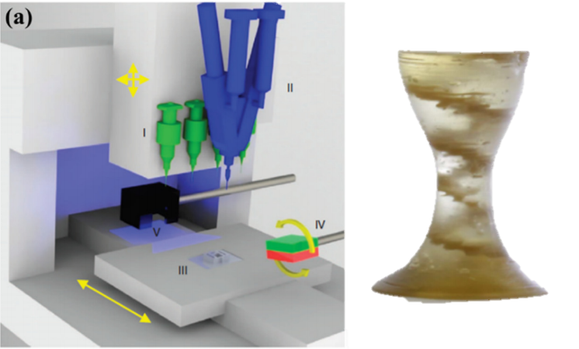
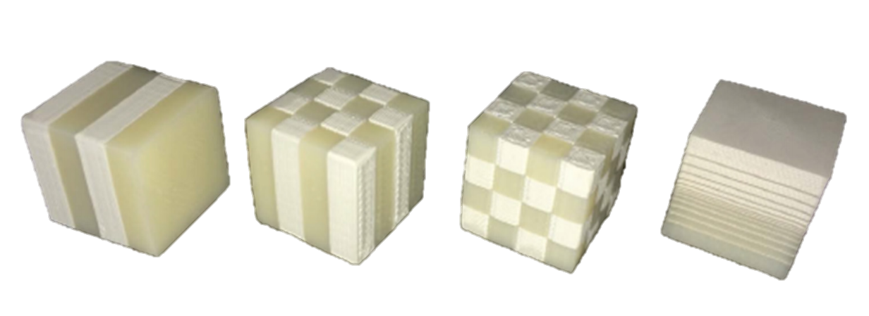
3D printing of polymer matrix composites
Works by Composite Materials and Structures Laboratory, University of Central Florida, Orlando
Simple Geometry (Cube) matrix Composites
Uncontrolled mixing of different materials to obtain any geometry

Slide 28
3D printing of polymer matrix composites
1
Generating two patterned point clouds in Matlab
2
3
Meshing the surface using best suitable method
4
5
6
Obtaining the features and shape for required part
Converting the Mesh into a solid object
Exporting the .Stl format
Dual 3D Printing!!

Slide 29
3D printing of polymer matrix composites
Trade study of various approches in generating surface from points:
Using simple Matlab functions like surf2stl, surf, etc.
Exporting the points in pointcloud format (.ply) and forming mesh in MeshLab software.
Importing pointcloud file (.xyz) in Solidworks using Scanto3D add-in.
Using binarization and isosurface technique to obtain required geometry.

Slide 30
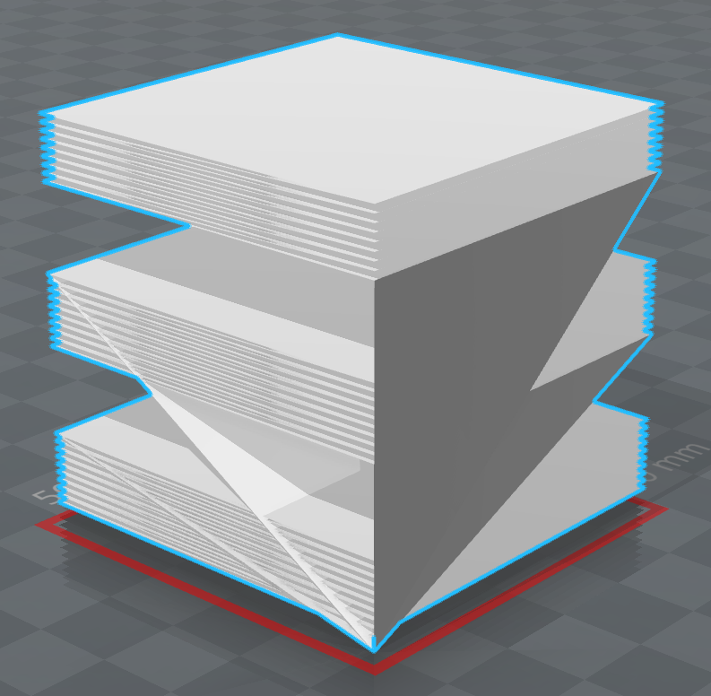
3D printing of polymer matrix composites
Using simple Matlab functions like surf2stl, surf, etc.
The function draws the planes with calculation from the lines connecting the points as seen from the results.

Slide 31
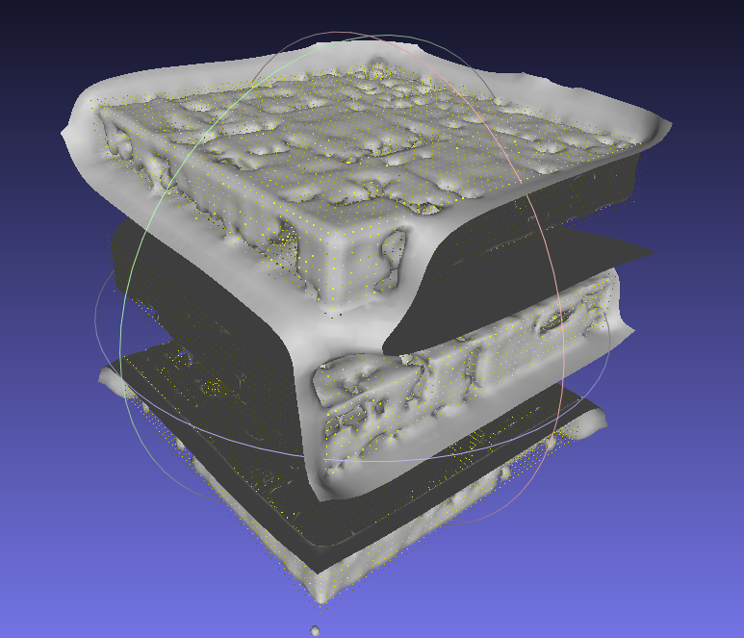
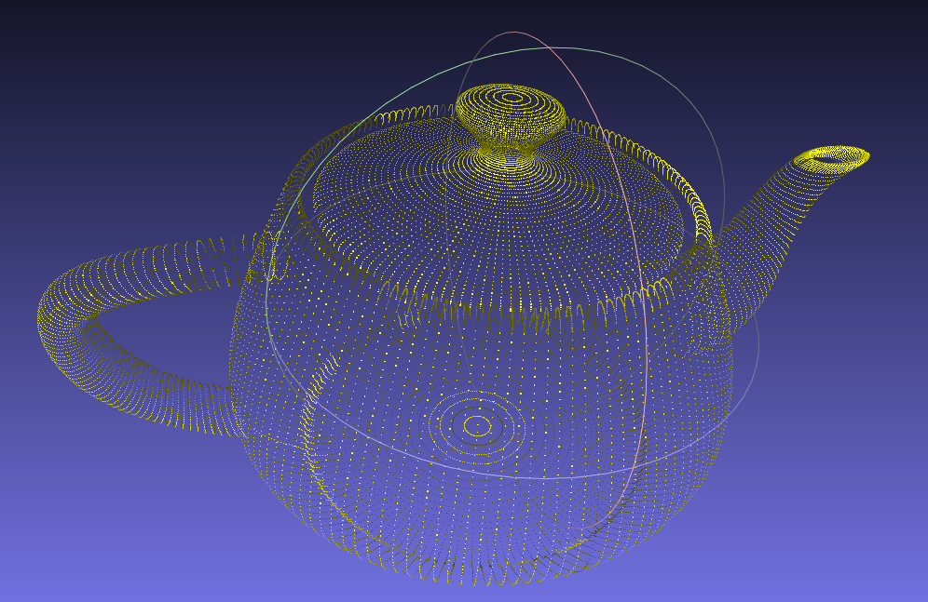
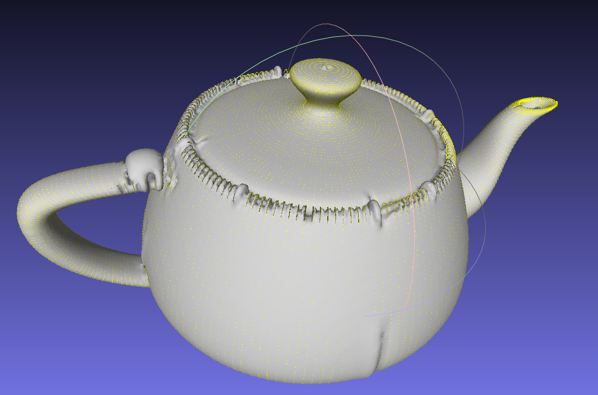
3D printing of polymer matrix composites
Using pointcloud in MeshLab
The open source software does a fine job except when large number of points are involved and points are too close to each other.
Fails when points are thoroughly spread inside the volume of the object.

Slide 32
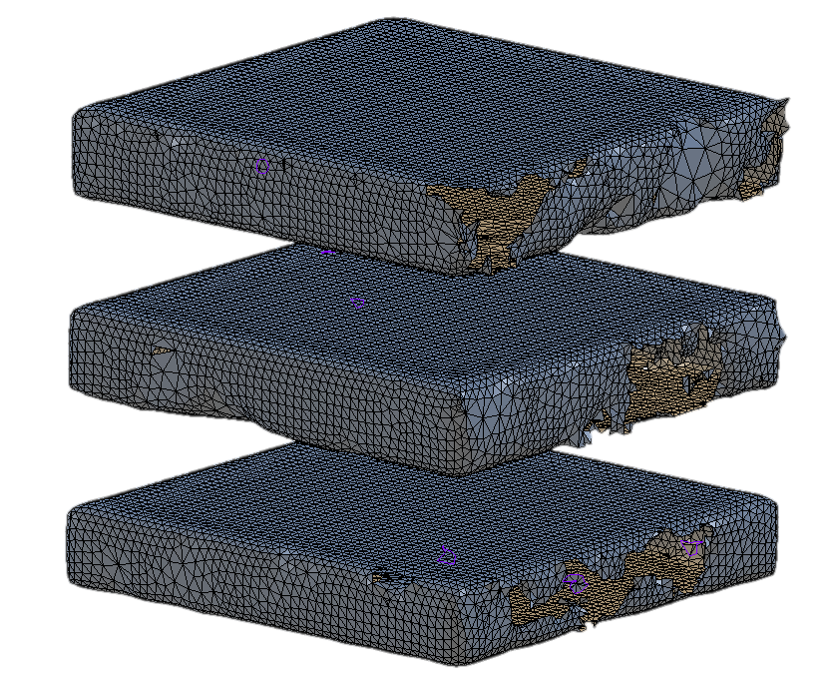
3D printing of polymer matrix composites
Importing pointcloud file (.xyz) in Solidworks using Scanto3D add-in.
The Add-in “Scanto3D” promises to give pretty results but the surface is not smooth and contains many holes.

Slide 33
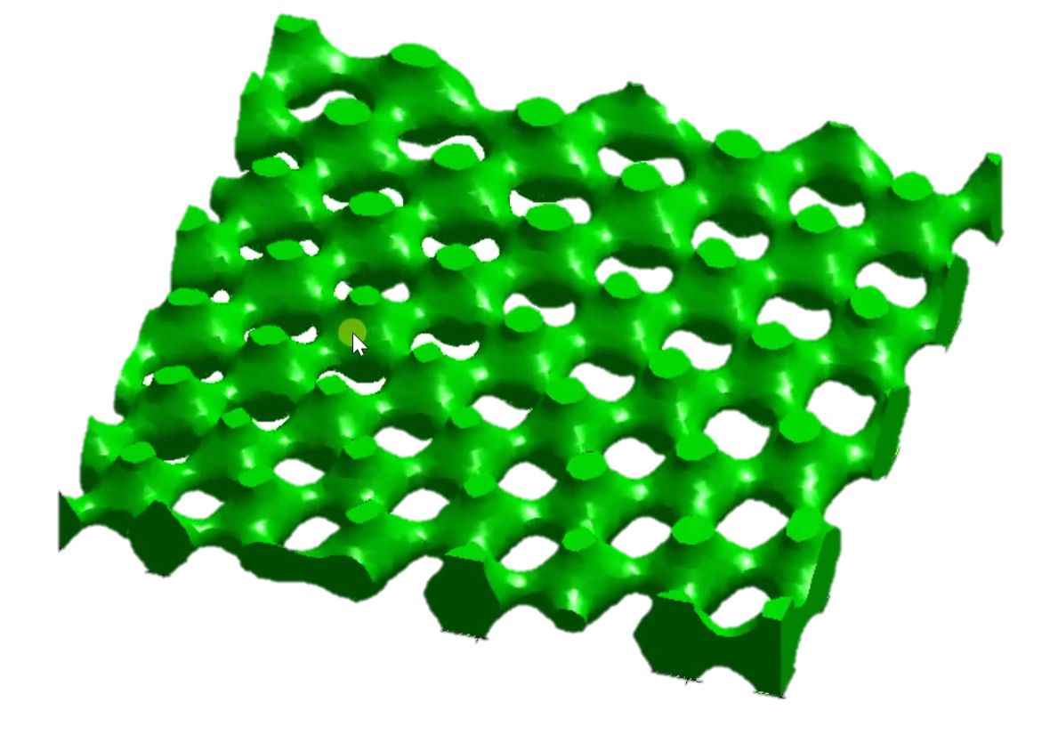
3D printing of polymer matrix composites
References have been found from the works by Prof. Raymond Rumpf where points in solid object are separated from the void space using Binarization.
The matlab function isosurface and isocaps helps in meshing the surfaces with equal weights.

Slide 34
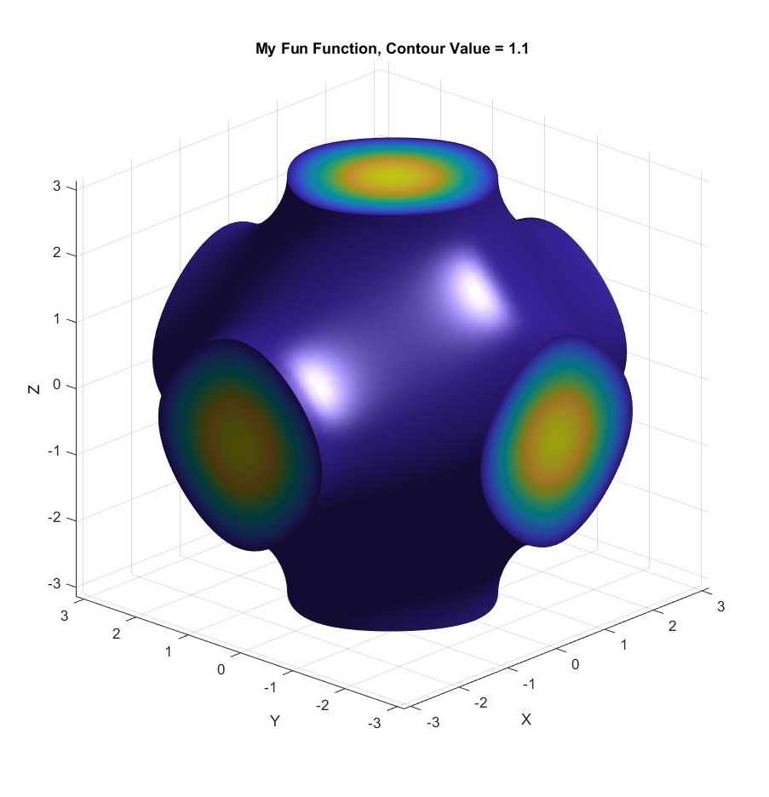
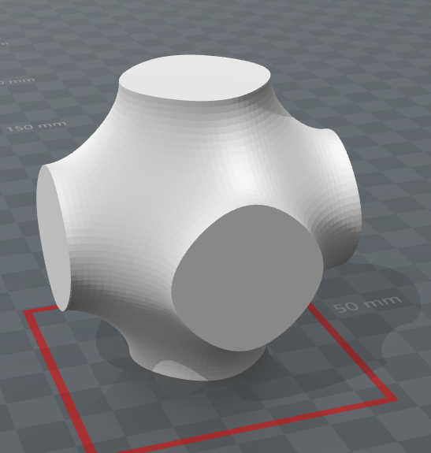
3D printing of polymer matrix composites
Results

Slide 35
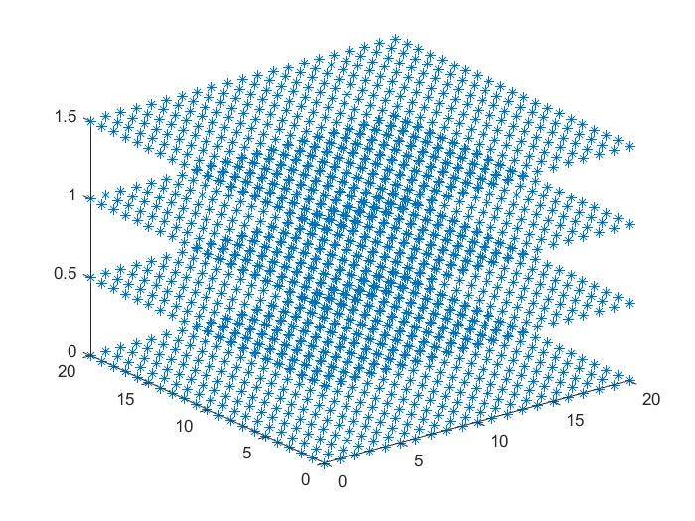
3D printing of polymer matrix composites
Results have been perfect in case of Continous surface.
Attempt is being made to form surface from discontinuous point cloud.
Trade off is to be done between the resolution of meshing and computation as higher resolution leads to large number of points.

Slide 36
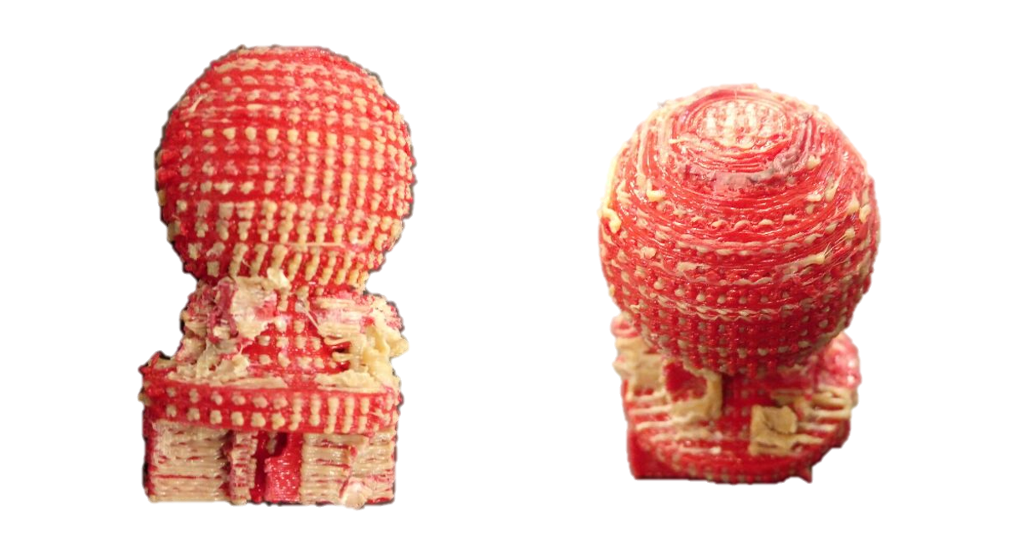
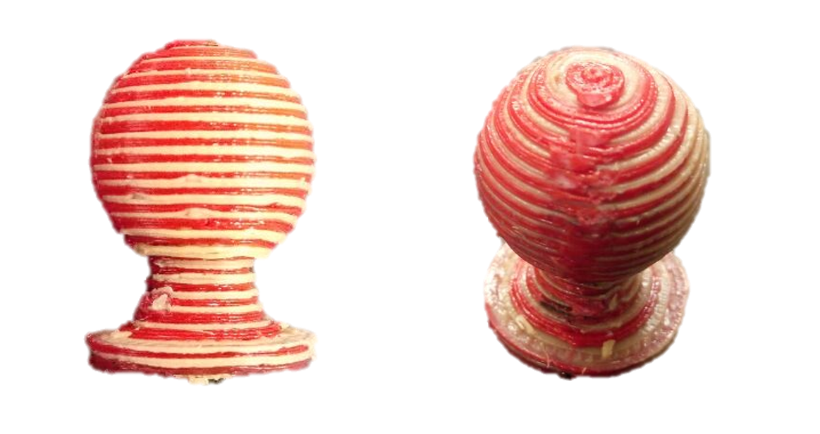
3D printing of polymer matrix composites
Line Mesh and Layer Mesh Pattern were created in SolidWorks
Line Mesh
Line Width = 0.2mm
Layer Mesh
Layer Width = 0.2mm

Slide 37
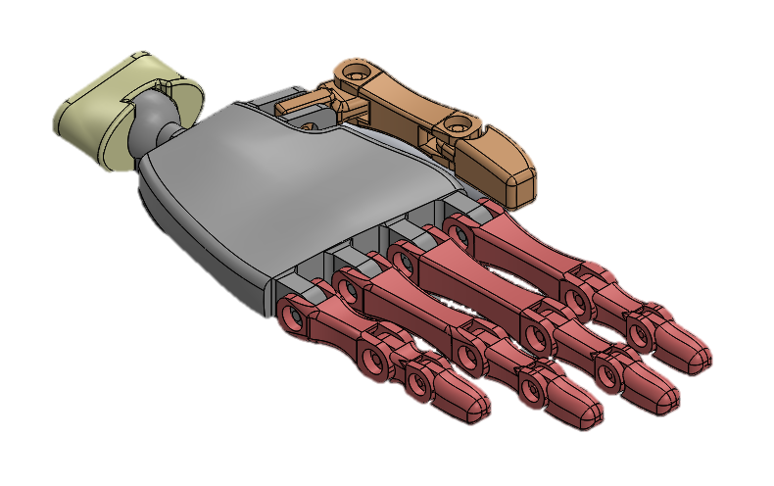
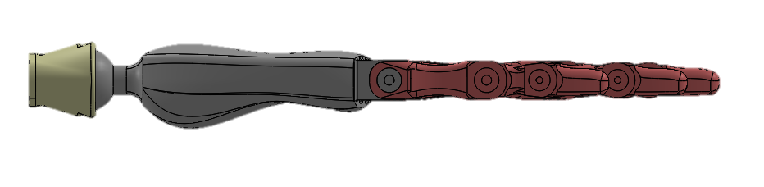
Hand Design
Working on design of hand for the robotic arm which is having anatomy similar to human hand.
The picture shows the new design of palm for a proper grip of objects.

Slide 38
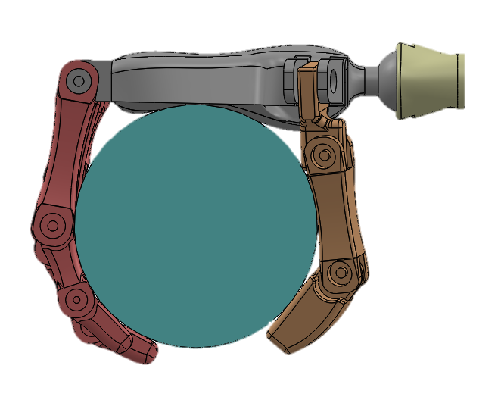
Hand Design
The image shows that how the grasp of a cylindrical object will take place using the hand.
Using a palm in the hand is giving a much better grasp than using only bone structure in the hand.

Slide 39
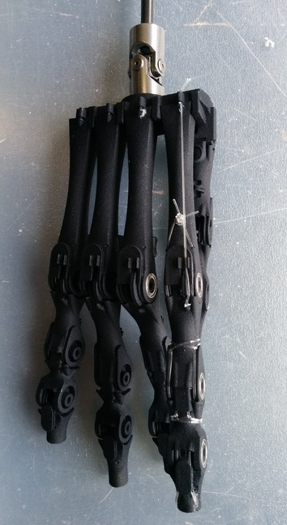
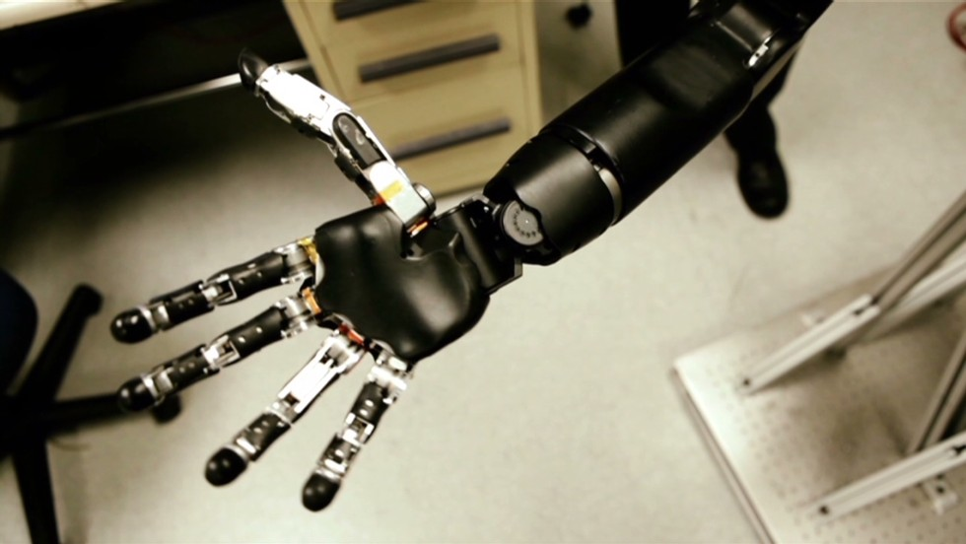
References
References for palm has been taken from the John Hopkins robotic prosthetic arm.
Design of fingers of Ecce robot was helpful for the design of fingers. Also, some length characteristics were taken from the human anatomy.

Slide 40
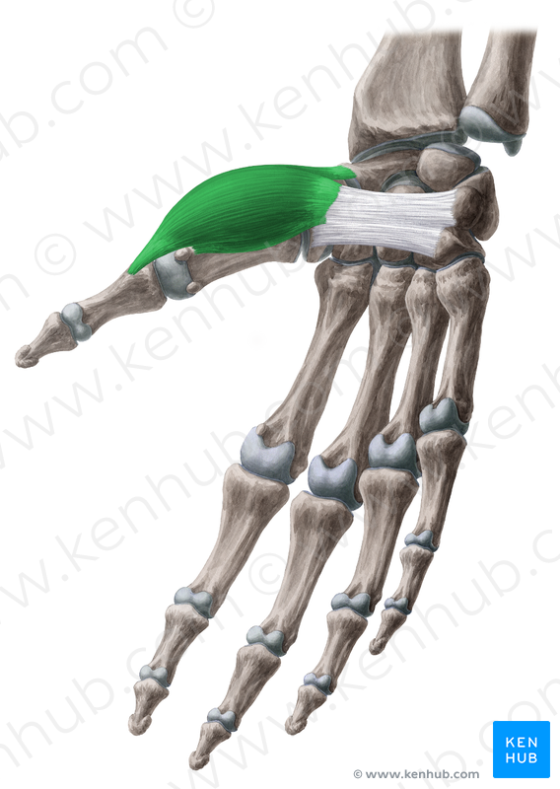
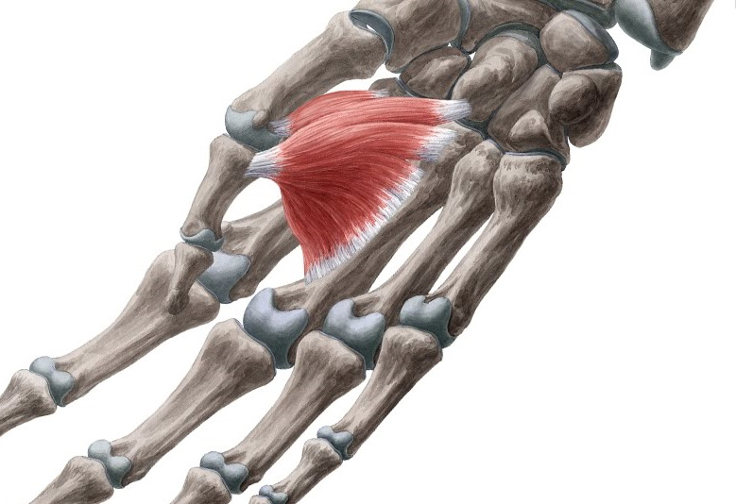
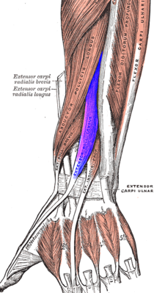
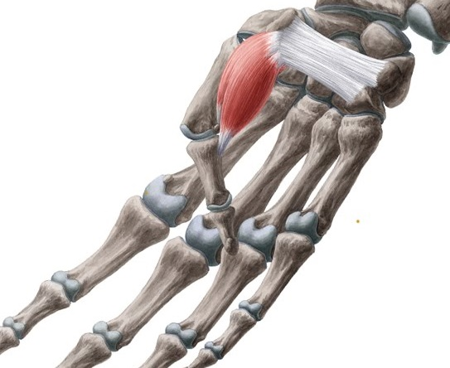
Motion of thumb and its muscles
The idea is to control the hand with 4 muscles by controlling the thumb adduction, abduction and its flexion and extension.
Abductor Pollicis Brevis, Aductor Pollicis, Flexor Pollicis Brevis, Extensor Pollicis Longus are the muscles used for thumb motion.
An idea is to attach muscle on forearm and use of string mechanism (like tendons) to control motion of hand.

Slide 41
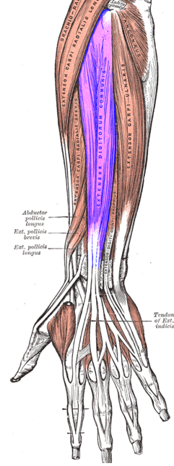
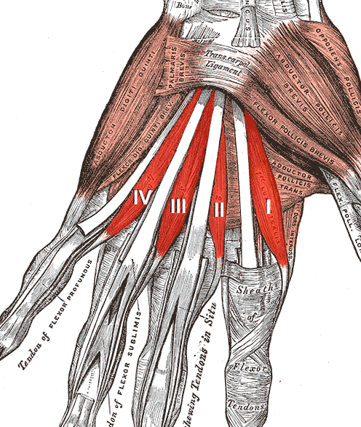
Fingers Motion and Muscles
For the motion of finger, agonists and antagonists pair of muscles will work for flexion and extension.
Lumbricals, Extensor Digitorum Muscles are used for the flexion and extension of the fingers.

Slide 42
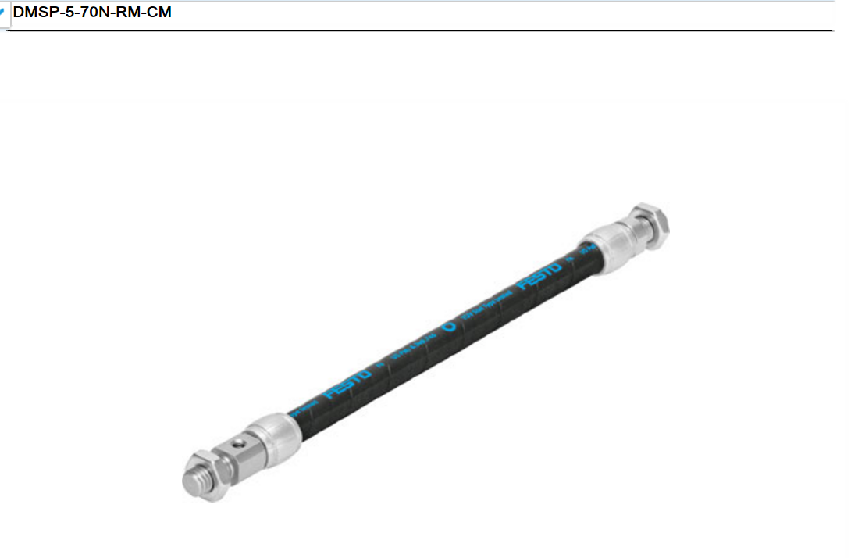
Festo Muscles
Festo provides the muscles of 5 mm diameter and 70 mm length.
These muscles will be much suitable and will also provide proper motion as per the study.

Slide 43
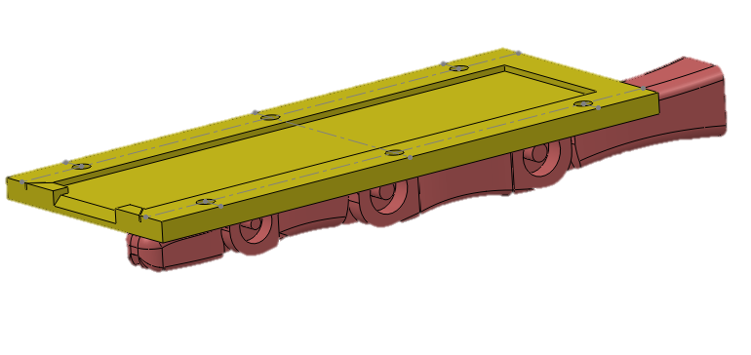
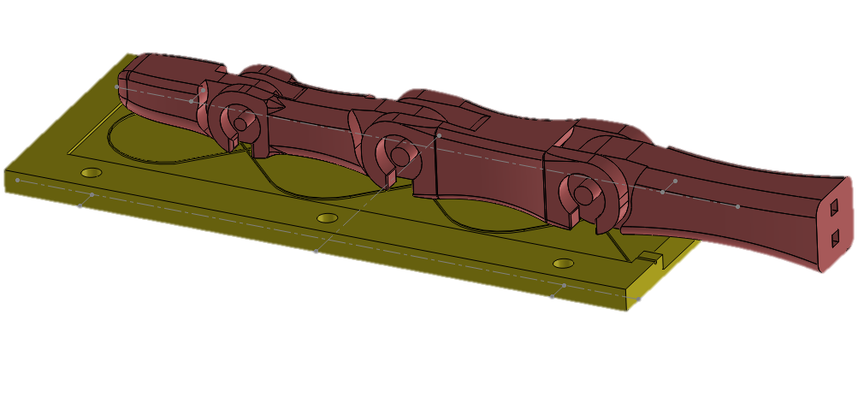
FBG sensor will be used as positional sensor from top side as shown in first figure.
This view shows the way to place the FBG sensor on the finger bone.

Slide 44
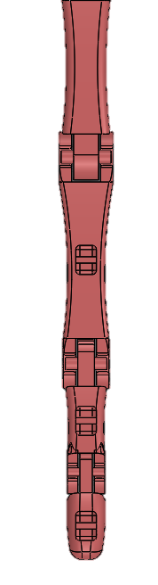

Finger Design

Slide 45

Finger Design with FBG Sensor
FBG Sensor will be used as touch sensor as shown in figure.

Slide 46


Slide 47

Graphene Strain Guage

